Slide 1





Slide 2


Leicester City won the EPL in 2016
Notes:
(Give some context for those who know and those who don't know)

Slide 3


Notes:
They were known as the crew of rejects, unknowns and never-weres
They had never won the title in its 132-year history
At the start of the season, bookmakers had Leicester at an incredible 5,000-1 to win the Premier League – greater than the odds on Kim Kardashian becoming the next US president

Slide 4

How did they win?
Notes:
They were by no means superstars and the odds were against them - They won because of two things

Slide 5
Everyone in that team knew their part to win, there were no silos
They understood the
Power of One
Notes:
Everyone in that team knew their part to win, there were no silos
Ranieri tapped into a winning mentality where the idea of mutual participation creates a self-reinforcing phenomenon.
They were a humble bunch of misfits who were incentivized with free pizza to get clean sheets and each game they played they got a little bit better and better and better
They understood the Power of One
-he went from regularly changing his team players to sticking to his preferred 11 players for 87% of the matches
instead of benching his players when they made mistakes he defended them which gave them confidence to make better choices and take calculated risks
he identified the teams strengths and weaknesses and hired players to fill the gaps

Slide 6
What you will
Learn
1
The 4 Chapters
2
The 3 big Cash Flow Measures
3
The Power of One
4
Projections and Valuations
5
Getting your Bank to say Yes

Slide 7



The
4 Decisions
People
Strategy
Execution
Cash
In order for companies to grow effectively they need to have a focus on the 4 key decisions.

Slide 8








Introducing
MILOK group
MILOK Group was founded in 2010 by George Milok
The Company imports and distributes haircare products, supplying
hairdressers,
beauty salons
and pharmacies
They employ 55 people
Execution
The Owner George wants to create a culture of financial visibility
The Goal is to achieve a valuation of $15M in 2 years

Slide 9
MILOK’s Group Financial Statements
Profit & Loss | 2020 | 2021
Revenue | 21,500,000 | 24,000,000
Gross Margin | 7,800,000 | 9,000,000
Overheads | 5,920,000 | 6,700,000
Operating Profit | 1,880,000 | 2,300,000
Interest | 80,000 | 100,000
Tax | 600,000 | 700,000
Net Profit | 1,200,000 | 1,500,000
Balance Sheet | 2020 | 2021
Cash at Bank | 100,000 | 100,000
Accounts Receivable | 4,000,000 | 5,000,000
Inventory | 2,500,000 | 3,200,000
Current Assets | 6,600,000 | 8,300,000
Fixed Assets | 3,000,000 | 3,000,000
Total Assets | 9,600,000 | 11,300,000
Accounts Payable | 3,000,000 | 3,500,000
Short Term Debt | 3,100,000 | 2,800,000
Current Liabilities | 6,100,000 | 6,300,000
Long Term Debt | 1,000,000 | 1,000,000
Total Liabilities | 7,100,000 | 7,300,000
Equity | 2,500,000 | 4,000,000

Slide 10

MILOK’s Group Chapter 1
Profitability
12 months ending 30-12-2021
Profitability Trends
Revenue
24,000,000
2,500,000
Gross Margin
9,000,000
1,200,000
40
30
20
10
0
36,3
37.5
35,3
31-12-2019
31-12-2020 – last period
31-12-2021 – this period
Operating
Profit
2,300,000
420,000
Retained Profit
1,500,000
300,000
8,3
8,7
9,6
5,3
5,6
6,3
Gross Margin %
Operating Profit %
Net Profit %

Slide 11


It is vital that you and your whole management team have access to and understand your financial story in a consistent framework so they are aligned and all working towards protecting the company’s cash during this time.
We are most likely to be in a situation where we need to make some tough decisions.
We need to be able to communicate both internally and externally with no ambiguity.
It has never been more important
to understand your numbers

Slide 12

REVENUE IS VANITY
PROFIT IS SANITY
CASH IS KING.
Cash

Slide 13


Your big 3
Cash Flow Measures
Net
Cash Flow
Operating
Cash Flow
Marginal
Cash Flow

Slide 14

Measure 1
Net
Cash Flow
Measure 2
Operating
Cash Flow
Measure 3
Marginal
Cash Flow
1st Jan 2021
Bank balance:
10,000
31st Dec 2021
Bank balance:
1,000
My Net Cash Flow is 9,000
Why can’t we apply this logic to our company even if it has multiple bank accounts?

Slide 15

MILOK Group
Net Cash Flow
Opening Net Debt
Short Term Debt | 3,100,000
Long Term Debt | 1,000,000
Less Cash | -100,000
4,000,000
Closing Net Debt
Short Term Debt | 2,800,000
Long Term Debt | 1,000,000
Less Cash | -100,000
3,700,000
Net Cash Flow | +300,000

Slide 16


Making your
Financial Statements simple
3
1
2
Your Income Statement and Balance Sheet are equally Important
Companies focus on their Income Statement because its easy to understand
Your Balance Sheet can be made simple

Slide 17



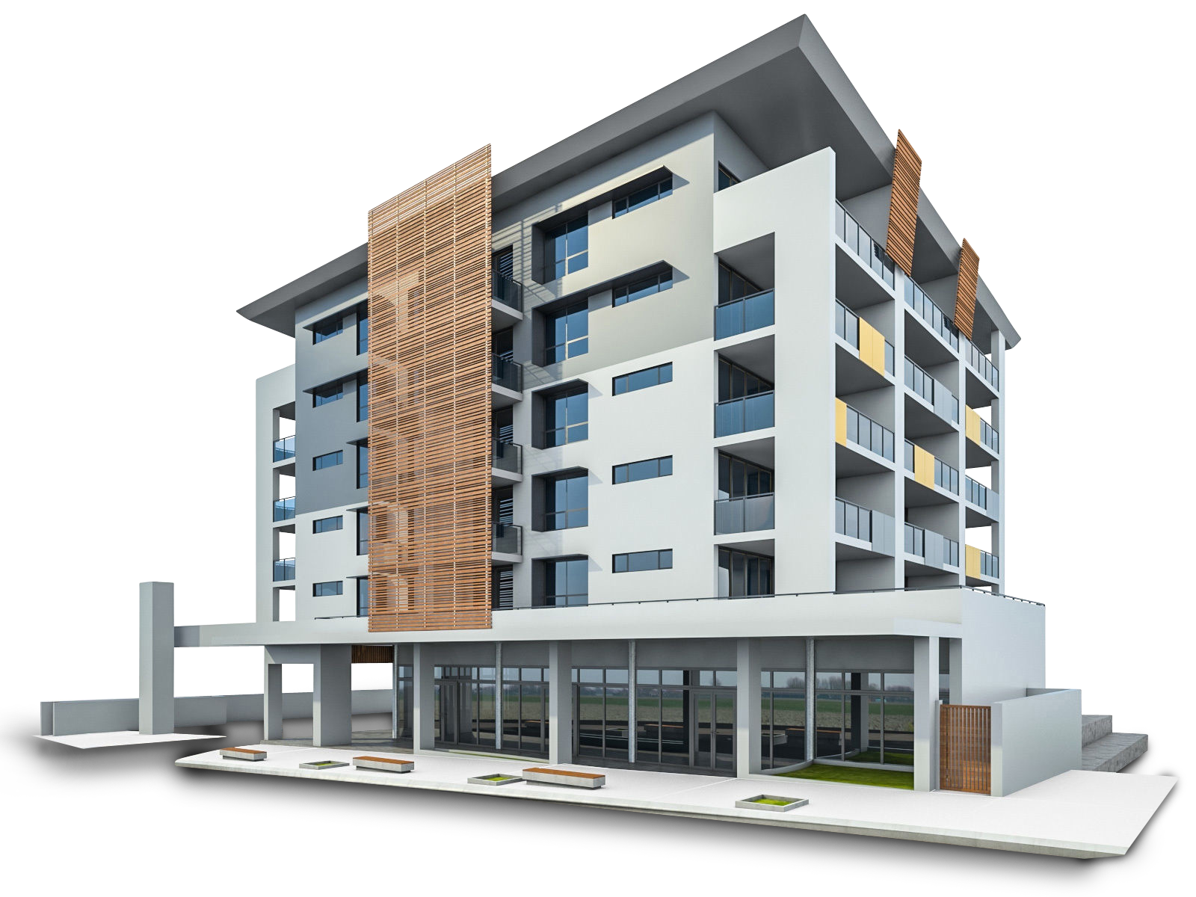

Your Balance Sheet in one sentence
Funding
Operations

Slide 18

MILOK Group Balance Sheet
In one sentence | Last year
+
Other & Capital
3,000,000
Equity
2,500,000
Net Debt
4,000,000
Working Capital
3,500,000
+
Funding
Operations

Slide 19
MILOK Group Balance Sheet
In one sentence | Current year
+
Other & Capital
3,000,000
Equity
4,000,000
Net Debt
3,700,000
Working Capital
4,700,000
+
Funding
Operations

Slide 20
MILOK Group Balance Sheet
In one sentence | Current year movement
1,500,000
-300,000
1,200,000
0
+
Other & Capital
3,000,000
Equity
4,000,000
Net Debt
3,700,000
Working Capital
4,700,000
+
Funding
Operations

Slide 21

The
4 Chapters
1
2
3
4
Working Capital
Other Capital
Profitability
Funding

Slide 22

Reconciliation of cash using the 4 Chapters
 | + Cash Flow | - Cash Flow
Profit | 1,500,000
Working Capital Invested |  | 1,200,000
Other Capital Invested |  | 0
Total | 1,500,000 | 1,200,000
Chapter 1
Chapter 2
Chapter 3
Chapter 4
Funding
Your business generated 300,000 of cash

Slide 23
The 4 Chapters
MILOK Group story
1
2
3
4
Working Capital
Other Capital
Profitability
Funding
MILOK Group have performed well in Chapter 1 Profitability metrics.
They have a lazy Balance Sheet due to poor
Chapter 2 Working
Capital Management.
This has resulted in Cash Flow wastage.

Slide 24
Your big 3
Cash Flow Measures
Net
Cash Flow
Marginal
Cash Flow
Operating
Cash Flow

Slide 25
Operating Cash Flow
Measure 1
Net
Cash Flow
Measure 2
Operating
Cash Flow
Measure 3
Marginal
Cash Flow
Operating Cash Flow is a critical measure for your management
team.
They are equally responsible for Chapter 1 Profit and Chapter 2 Working Capital.
MILOK like many companies has a blind spot. They focus on Profit and do not understand Cash.
Operating Cash Flow is a simple measure to help bridge this gap.

Slide 26
Operating Cash Flow
Measure 1
Net
Cash Flow
Measure 2
Operating
Cash Flow
Measure 3
Marginal
Cash Flow
is a critical measure
MILOK grew their Revenue by 12%
Operating Profit
increased by 22% to
$2,300 million
MILOK had a positive Cash Flow of only
$300,000

Slide 27

Cash Flow
quality of management
Growth/ Decline
Cash Flow
Wastage
Management
Gains

Slide 28
What changed since last year?
 | Changes
Revenue | + 12%
Gross Margin | + 0.75%
Overheads | + 15%
Accounts Receivable | +8 Days
Inventory | + 11 Days
Accounts Payable | + 5 Days

Slide 29
Cash Flow quality of management
 | Gains | Wastage
Gross Margin | 1,200,000
Overheads |  | 780,000
Accounts Receivable |  | 1,000,000
Inventory |  | 700,000
Accounts Payable | 500,000
Total | 1,700,000 | 2,480,000
Management negatively impacted cash by 780,000

Slide 30
Profitability | Ideal Profile | Good | Average | Bad
Sales | 100
GM % | 40 | >40 | 37-40 | <37
OH % | 28 | <28 | 28-30 | >30
EBIT % | 12 | >12 | 10-12 | <10
Working Capital
Receivable days | 60 | <60 | 60-70 | >70
Inventory days | 50 | <50 | 50-60 | >60
Payable days | 60 | >60 | 45-60 | <45
Cash Flow quality

Slide 31
Profitability | Ideal Profile | Good | Average | Bad
Sales | 100
GM % | 40 |  | 37,5
OH % | 28 |  | 28
EBIT % | 12 |  | 9,5
Working Capital
Receivable days | 60 |  |  | 76
Inventory days | 50 |  |  | 78
Payable days | 60 | 85
Cash Flow quality
– MILOK’S numbers

Slide 32
Your big 3
Cash Flow Measures
Net
Cash Flow
Operating
Cash Flow
Marginal
Cash Flow

Slide 33

Measure 1
Net
Cash Flow
Measure 2
Operating
Cash Flow
Measure 3
Marginal
Cash Flow
Marginal Cash Flow
Marginal Cash Flow is the additional cash that will be generated or used up if we sell $1 more of our product or services.
Most companies only look at their Gross Margin
You cannot grow without needing Chapter 2 Working Capital
Marginal Cash Flow takes both Gross Margin and Working Capital into account

Slide 34

Marginal Cash Flow for the next $1 of sales
Working Capital
20
Inventory
13
Inventory
3,200,000
Receivables
5,000,000
Payables
3,500,000
Receivables
22
Payables
15
For each additional $100 of Revenue you invest $20 in Working Capital
Revenue
24,000,000

Slide 35
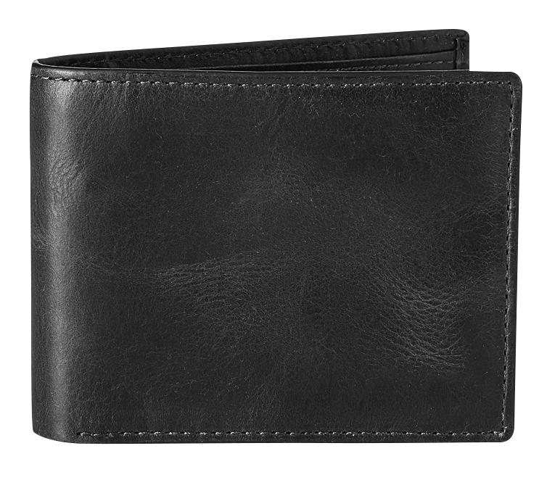
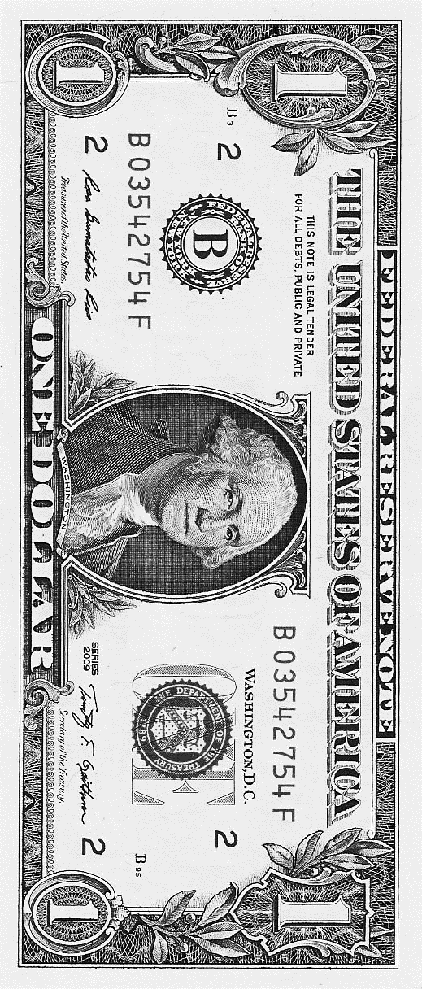
As MILOK grows for every $1
Gross Margin
Working Capital
GAP is $0.18
The
$0.38
$0.20
As MILOK grows for every $1 of revenue they will generate $0.38 of Gross Margin but requires $0.20 of Working Capital resulting in a gap Marginal Cash Flow of $0.18

Slide 36
Marginal Cash Flow
by segment
Branch | GM% | AR Days | WIP Days | WC% | GM%-WC% | Rank
Melbourne Economics | 48 | 60 | 15 | 18 | 30 | 1
Sydney Planning | 50 | 82 | 24 | 26 | 24 | 2
Consumer Research | 48 | 90 | 12 | 25 | 23 | 3
Melbourne Planning | 50 | 76 | 30 | 27 | 23 | 3
Melbourne Design | 31 | 30 | 23 | 11 | 20 | 5
Sydney Design | 46 | 66 | 45 | 28 | 18 | 6
International Property | 58 | 132 | 42 | 45 | 13 | 7
Perth Planning | 29 | 59 | 22 | 18 | 11 | 8
Brisbane Planning | 45 | 106 | 38 | 37 | 8 | 9
Valuation | 46 | 78 | 72 | 39 | 7 | 10
Perth Design | 30 | 56 | 44 | 24 | 6 | 11
Sydney Social Policy | 37 | 67 | 80 | 37 | 0 | 12
Brisbane Property | 25 | 67 | 42 | 26 | -1 | 13
Sydney Property | 29 | 104 | 21 | 31 | -2 | 14
Telco | 16 | 78 | 20 | 23 | -7 | 15
Sydney Heritage | 12 | 37 | 58 | 21 | -9 | 16
Brisbane Design | 47 | 163 | 91 | 67 | -20 | 17

Slide 37

The Power of One
The Power of One is the code of your business. It will improve Profit, Cash Flow and Value.

Slide 38
The Power of One
Your 7 levers to improve Profit, Cash Flow and Business Value:
1
2
3
4
Price %
Volume %
COGS/Direct Costs %
Overheads %
5
6
7
Accounts Receivable Days
Inventory/ WIP
Accounts Payable Days

Slide 39
MILOK’s the Power of One
Your Power of One
-
1.0
+
Impact on Cash Flow
Impact on Profit
Price Increase %
Volume Increase %
COGS Reduction %
Overheads Reduction %
Reduction in Accounts Receivable days
Reduction in Inventory days
Increase in Accounts Payable days
Your Power of One Impact
-
1.0
1.0
1.0
1.0
1.0
1.0
1.0
+
%
%
%
%
days
days
days
190,000
43,000
147,000
67,000
65,753
41,096
41,096
594,945
240,000
90,000
150,000
67,000
547,000
-
+
-
+
-
+
-
+
-
+
-
+

Slide 40
The Power of One – MILOK’s strategy
Your Power of One
-
1.0
+
Impact on Cash Flow
Impact on Profit
Price Increase %
Volume Increase %
COGS Reduction %
Overheads Reduction %
Reduction in Accounts Receivable days
Reduction in Inventory days
Increase in Accounts Payable days
Your Power of One Impact
-
2.0
0.0
0.0
0.0
7.0
0.0
0.0
+
%
%
%
%
days
days
days
380,000
0
0
0
460,274
0
0
840,247
480,000
0
0
0
480,000
-
+
-
+
-
+
-
+
-
+
-
+

Slide 41
Working capital timeline
MILOK has had 14 Days of Power of One changes in its Working Capital Management
Working Capital Time
12 months ending 30-06-2021
Day 85
Creditors Paid
Day 154
THIS
PERIOD
Day 0
Cash Banked
69
Working
Capital Days
Inventory Arrives
Day 78
Inventory Sold
-782,329
Cash Impact
Day 80 Creditors Paid
Day 135
Cash Banked
LAST
PERIOD
Day 0
55
Working
Capital Days
Inventory
Arrives
Day 67
Inventory Sold

Slide 42
Price
Idea 1
Idea 2
Idea 3
Volume
Idea 1
Idea 2
COGS
Workshopping the Power of One
Idea 1
Idea 2
Idea 3
Overheads
Idea 1
Idea 2
Idea 3
Accounts Receivable
Idea 1
Idea 2
Inventory
Idea 1
Idea 2
Idea 3
Accounts Payable
Idea 1
Idea 2

Slide 43

The Power of a Shoe Example
Average Selling Price per Shoe |  |  | 175
Gross Margin | 61% |  | 106.75
Occupancy | 23.18% |  | 40.57
Staff Retail | 16.81% |  | 29.42
Admin | 4.05% |  | 7.09
Oncosts | 3.92% |  | 6.86
Promotion | 2.14% |  | 3.75
Finance | 1.18% |  | 2.07
Freight | 2.57% |  | 4.50
Depreciation | 2.48% |  | 4.34
Other | 4.10% |  | 7.18
Total Costs |  |  | 105.75
Total profit per shoe |  |  | 1.00

Slide 44
The Power of an Hour Example

Slide 45


MILOK believes that the Company is worth $15 million
What is it actually worth?
Weighted Average EBITDA $2 million X Profit Multiple 4 =
Gross Valuation $8 million
MILOK has Bank Debt of $3.7 million which will need to be settled from their proceeds.
Value Gap
Targeted Business Value
15,000,000
Current Business Value
4,300,000
Profit multiple of 4
Current Value Gap
-10,700,000

Slide 46

Profit Multiple | 4.00
Price Increase (2%) | 1,920,000
Volume Increase (0%) | 0
Direct Costs Reduction (0%) | 0
Overheads Reduction (0%) | 0
Profit Impact on Valuation | 1,920,000
Reduction in Accounts Receivable days (7d) | 460,274
Reduction in Inventory days (0d) | 0
Increase in Accounts Payable days (0d) | 0
Cash Impact on Valuation | 460,274
Your Power of One Impact | 2,380.274
Power of
One Value Uplift

Slide 47




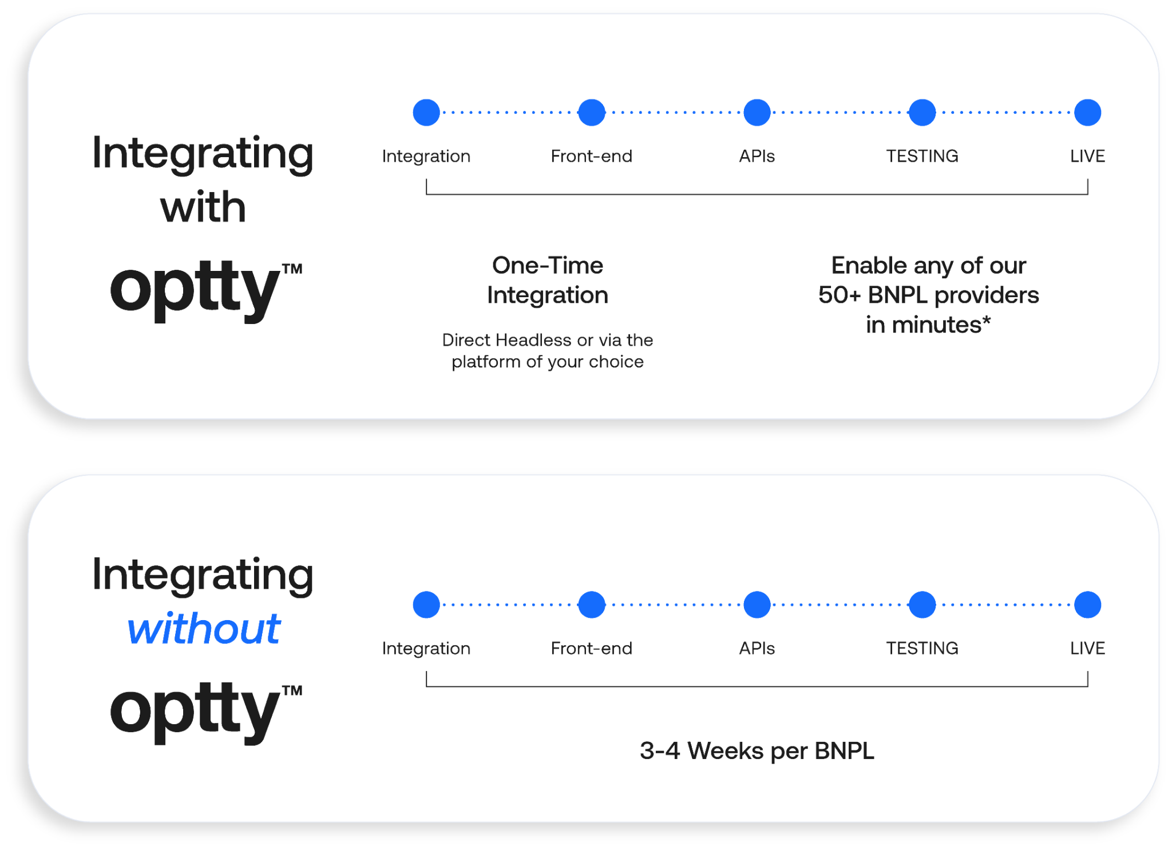
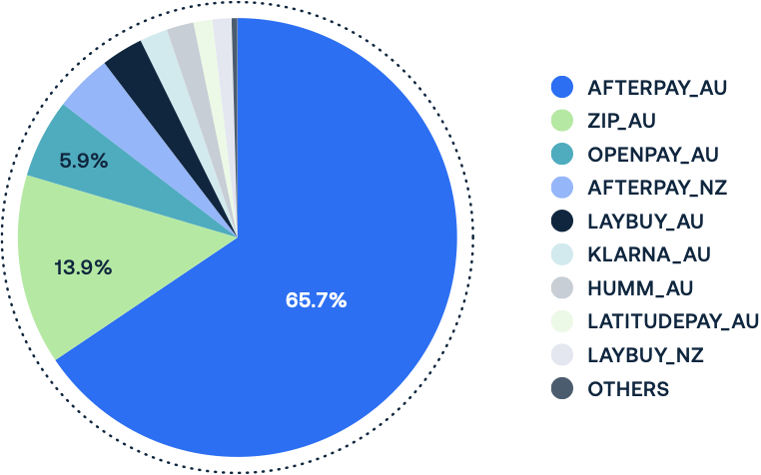
Optty achieving the POWER OF ONE in Buy Now Pay Later
“ONE INTEGRATION, 50+ Buy Now Pay Laters”
Instant increase in Gross Sales - New Zealand, USA & Australia
New Zealand - 3 Buy Now Pay Laters Launched
Increased BNPL Sales by 40.6%
Australia - 7 Buy Now Pay Laters Launched
Increased BNPL Sales by 21%
AOV Increased by 3%
ONE integration, 9 Buy Now Pay Laters live in 3 countries, configured in 40 minutes

Slide 48

You’re still in the game…
…and the ball has been passed to you

