Slide 1





#CelebrateSuccess

Slide 2

The Retailers’ Journey and Insights Gathered Along The Way
Trends that Retailers can use
Big News for Kepler & our Retailers
David Gordon – CEO, Kepler Analytics
David Mah – Managing Director

Slide 3


Earlier – Trend 1 – Traffic on Mondays, Tuesdays
Day weighting has shifted

Slide 4
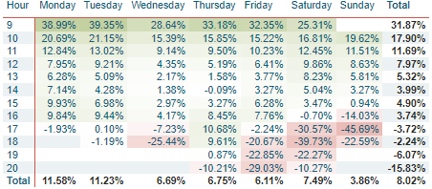
Earlier – Trend 2 – Earlier in the Day esp. Weekends
Times of day have also shifted

Slide 5
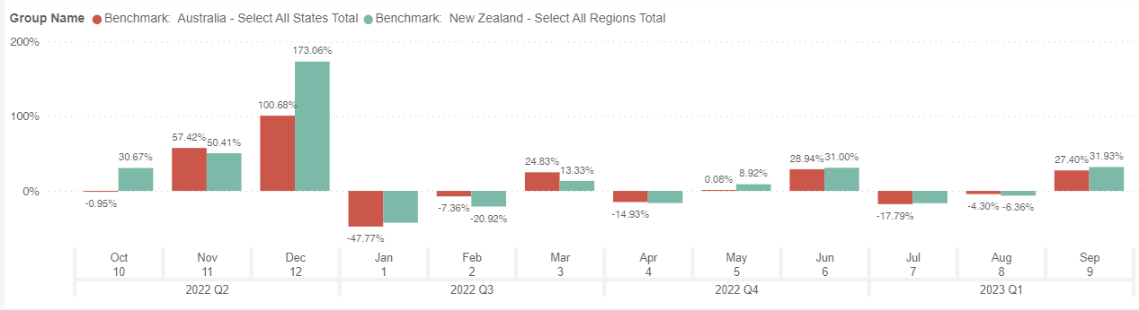
Sales $ v Last Year (monthly)
Uncertainty is a certainty
Verse 2021 the results look good – but affected by some closedowns last year
Sales are unpredictable – budgeting becomes a real art
Source: The Kepler Retail Index (KRI)

Slide 6
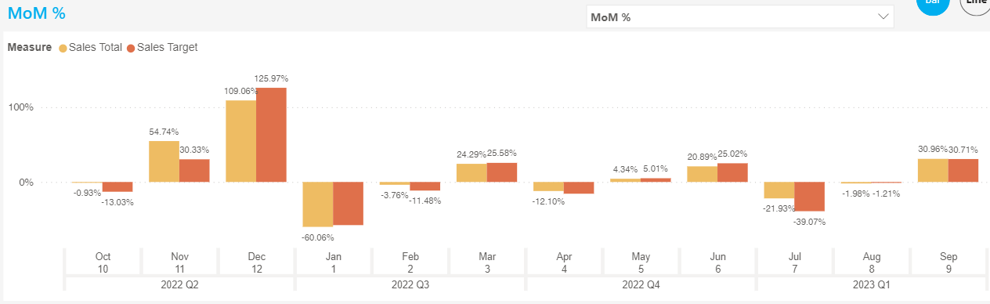
How are Retailers at Predicting/Forecasting?
Graph shows Sales $ and Target $ v LY
Generally, we have become quite effective at budgeting
On a Last Year comparative basis
Source: The Kepler Retail Index (KRI)

Slide 7
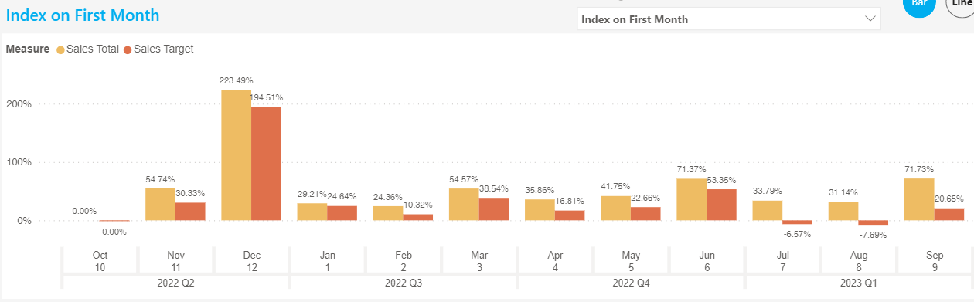
How are we doing this year to date?
But on a more short-term forecasting view, we have been more pessimistic this year (red bar lower than orange bar)
Graph shows our budgets $ v sales $ indexed to October 2021
Source: The Kepler Retail Index (KRI)

Slide 8
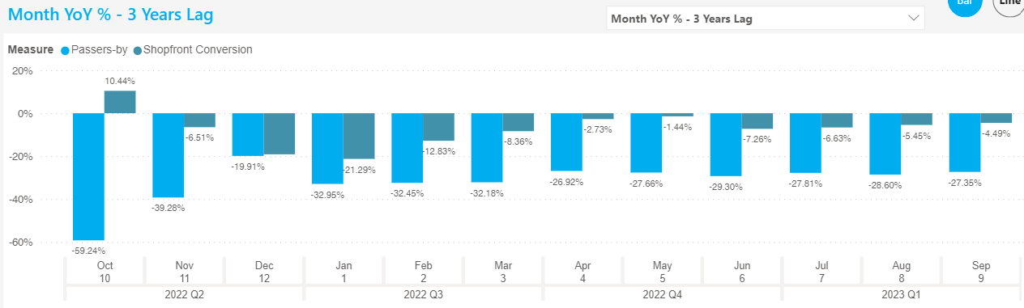
Traffic challenge #1: Getting them near your store
There is a massive difference in ‘visitors in the centre’ v ‘inside traffic in the retail stores
Traffic into centres with DEPTH are still below FY19, ~20% - 30% lower mark
When they arrive past your store, they are there to ENTER
The relevance of your brand to their predetermined visit is critical
Source: The Kepler Retail Index (KRI)

Slide 9
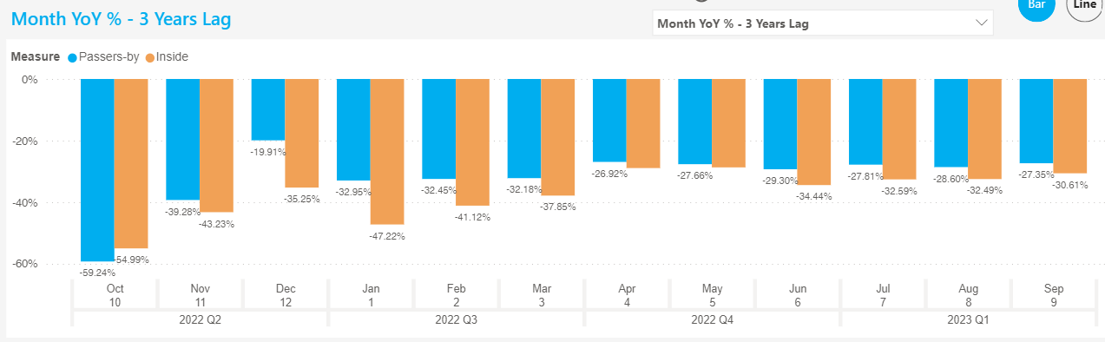
Traffic challenge #2: Getting them into the store
Inside Traffic is still down v FY19
The graph indicates they are visiting the location, but being selective as to where they shop
Again, indicates the incredible importance of ‘brand’ and online as a relevance trigger
Source: The Kepler Retail Index (KRI)

Slide 10
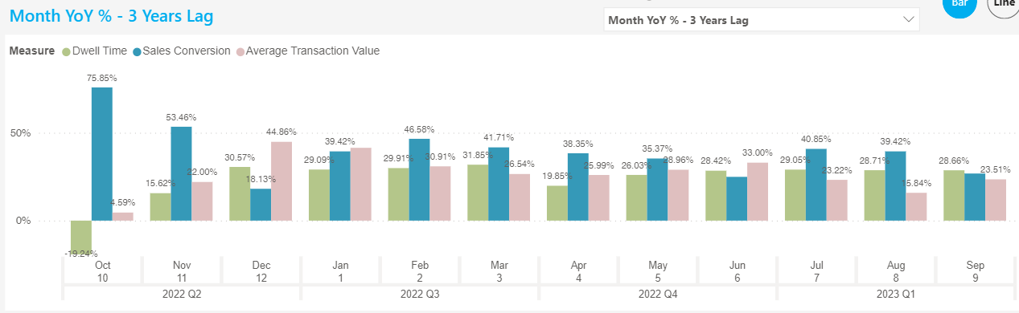
Once they enter the store, outcomes are good?
They come to purchase (Conversion Rate) and maximise (ATV) their visit
They make the decision & then spend the time (Dwell Time higher)
Source: The Kepler Retail Index (KRI)

Slide 11
So what have we learnt so far?
Traffic is still lower than FY2019 and continues to be a challenge
Primary reason for their visit – a considered decision
Secondary reason – impulsive
Remember – Retail = Location…Location…Location?
  Still true, but relates to Convenience of Location more than on the spot impulsive
In store focus must be service
  Spending more time, buying more items
  Knowledgeable, want added value service

Slide 12
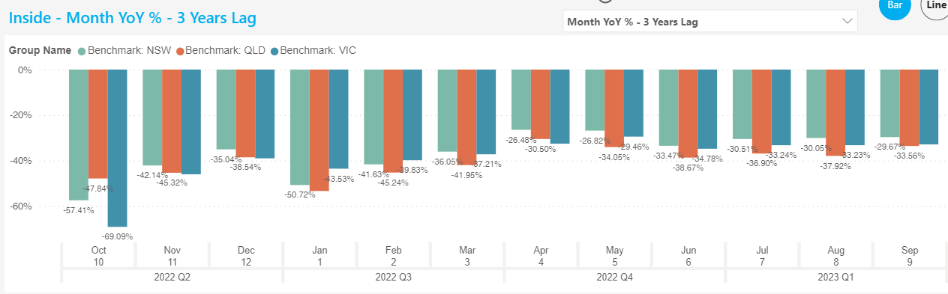
Inside Traffic in VIC, NSW, QLD
Source: The Kepler Retail Index (KRI)
They come mmmmmm

Slide 13
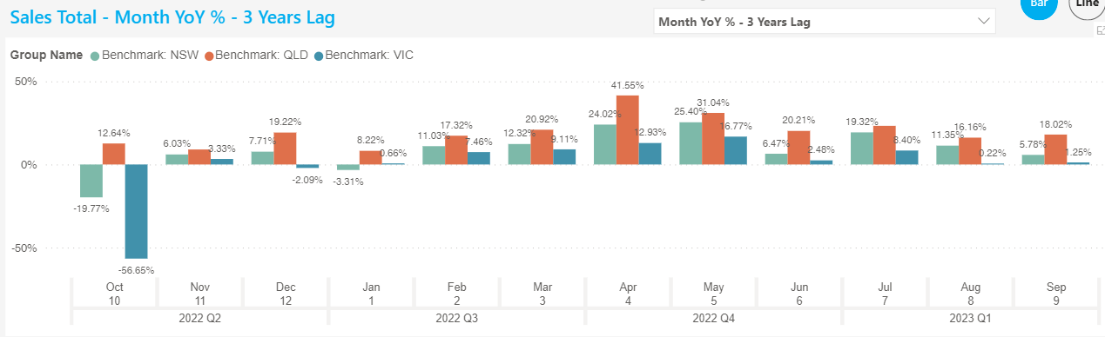
Sales comparison VIC, NSW, QLD
Source: The Kepler Retail Index (KRI)

Slide 14

Kepler and Countwise Merger
Close to 100 staff
>500 retailers >20,000 locations
Field Operations
Offices Melbourne (HO), Miami, Chicago, London
The offer:
  Outside and Inside counts
  Deep store customer behaviour
  Analytical Dashboards
  And more….

Slide 15

Kepler and Countwise Merger
Comprehensive global retail trends
  By country
  By retail sector
Seasonal trends – in advance
Kepler Store Network Toolkit
  Outside Traffic x Conversion In…
    Inside Traffic x Sales Conversion…
      # Transactions x ATV $
        Sales $
A Bottom Up Revenue Forecast Model
With the Selected Location Traffic Trends

Slide 16
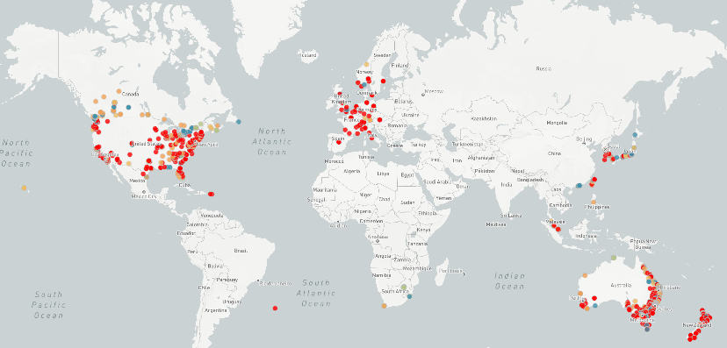
Kepler only locations

Slide 17
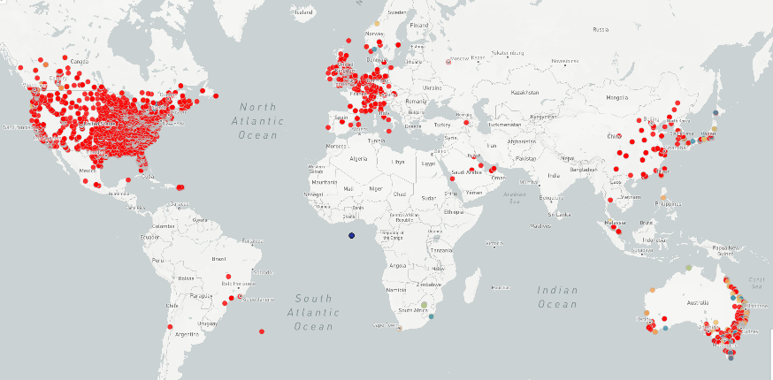
Countwise Kepler locations

Slide 18
Enjoy your day

Slide 19

Opening Statement
David Mah – Managing Director

Slide 20

Making Financials and Cashflow Easy and Simple
Alan Miltz – Founder, CashFlow Story
Alan Miltz has dedicated his life to helping business leaders and everyone in their team love the numbers. Alan is a co-author of the global best-selling book by Verne Harnish, Scaling Up. Alan believes that running a business is like managing a sports team, everyone needs to know the score. Every business wants to scale up their profit, cash and value.

Slide 21

New Products
Tony De Fazio – Director of Product

Slide 22
Key Drivers of Product Development Activity

Slide 23

Four Key Pain Points
1. If the volume of in store traffic is reduced….
Maximise the engagement of traffic in store, and increase the value of transacting customers

Slide 24
Four Key Pain Points
2. If traffic entering a shopping precinct remains far more predisposed and intentional…
Maximise my ability to reach engaged & purposeful traffic

Slide 25
Four Key Pain Points
3. If costs are rising…
Minimise my controllable expenses

Slide 26
Four Key Pain Points
4. If my customers are more intentional when entering my stores…
Extract more value from merchandise by increasing relevant “stock connectivity”

Slide 27

Kepler Journey Mapping & Basket Mapping

Slide 28

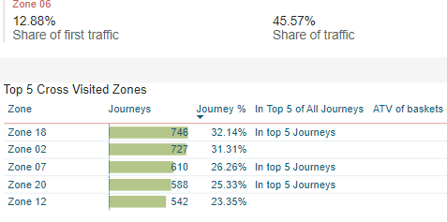
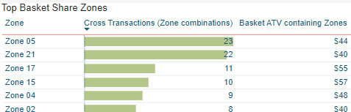
Understand the most valuable journeys in store – quantify the journeys that deliver the most sales for your store
Quantify opportunities of journeys- Understand “gaps” between journeys and baskets and the values of those gaps to prioritise actions
Identify the basket gaps- increase merchandise effectiveness by aligning to customer journey
Utilise store presence and Dwell Time – by increasing the value and volume of items in the customer journey
Kepler Journey Mapping & Basket Mapping

Slide 29
Live Demo

Slide 30
Kepler Store Network Toolkit

Slide 31

Why a Store Network Toolkit?
Rent
Size
Sales
Sales
Relevant Traffic
Operational Excellence

Slide 32

Three Key Talking Points
What a retailer pays rent for is not the primary ingredient of sales success.
The more operationally excellent a retailer is, the more rent they pay.
“Centre Traffic” and “Outside Traffic” are vastly different concepts.

Slide 33
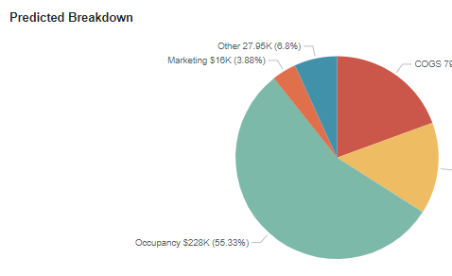
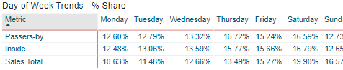
Benchmark your centres and locations- understand how your stores are performing, valued and are delivering within their centres
Assess New Sites within an existing centre- evaluate the likely performance of new potential sites – plot them within your existing network
Quantify True Portfolio Cost- Find opportunities for rental reductions
Gain Operational Efficiency- Identify stores that are not utilizing their Passing Traffic
Kepler Store Network Toolkit Key Benefits

Slide 34
Live Demo

Slide 35






Kepler User Panel
Phebe Bartle
Head of Retail
Ben Nau
Head of Retail
Tennille Lee
Senior Management Accountant - Retail

Slide 36
Kepler Retail Index
Benchmarking at a click
Tony De Fazio – Director of Product

Slide 37

Agenda
Section 1 – KRI Overview
Section 2 – Use Cases
Section 3 – Live Demo

Slide 38
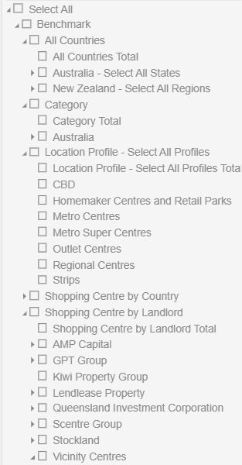
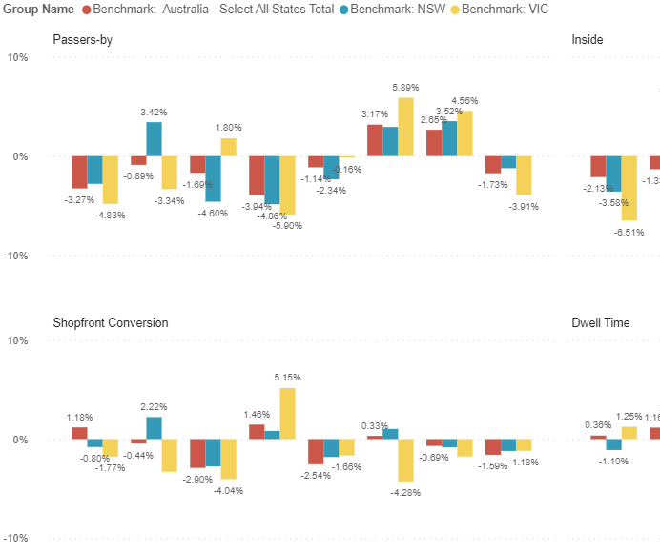
Kepler Retail Index - Overview
% Variance across the aggregated Groups
2,200+ Stores across Australia and New Zealand
Geographic Aggregations – country, state/island
Category – various retail categories and sub-sectors
Location Profile – physical structure, affecting shopping purpose
Shopping Centres – isolated dependant on coverage in centre
Landlords – key major property holders

Slide 39
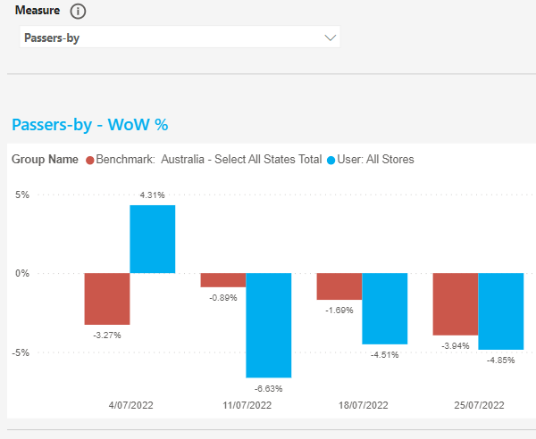
Kepler Retail Index - Perspectives
View | Purpose | Kepler Retail Clients | Kepler Non Retail Clients
KRI – Compare Groups | Contrast any group/s of stores for a single metric over time | R | R
KRI – Compare Measures | Compare multiple metrics for a single group over time | R | R
KRI – Compare Groups and Measures | Compare any group/s for a single metric over time (3 measures on the one screen) | R | R
KRI – Facet Table | Compare any group/s for a single metric over time (all measures on the one screen) | R | R
Store vs Shopping Centre Variance | Compare your store performance to shopping centre trends | R
Store vs State Variance | Compare your store performance to relevant state trends | R

Slide 40
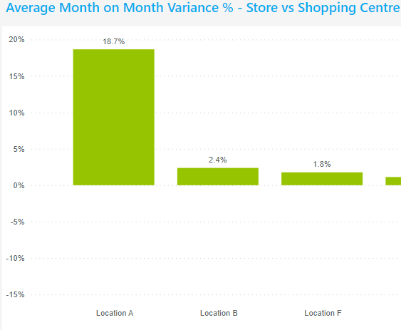
Kepler Retail Index – Time Lines
% Variance across the aggregated Groups
Time Periods: Week, Month, Quarter
Fixed Historical Comparisons
Period on Period
Period on Year
Aggregated Perspective
First Week Index
Rolling Aggregations
MAT Period on Period
Period MAT Year on Year
Period on 2 Year
Period on 3 Year
Period YTD Year on Year

Slide 41
Kepler Retail Index – Use Cases
Benchmarking
How are stores, clusters, groups performing versus Benchmark groups? Did we win? If so, why?
Location Hit List
Which centres are trending up or down? Where should my Property team start to look? Where am I at risk?
Trends
What are the key trends in the industry? In my category? What metrics are driving success? Where are my competitors succeeding? Where are the gaps I can exploit?

Slide 42

How your Store & Area Managers
should be using Kepler
Kylie Smart – General Manager, Customer

Slide 43
Outcomes
We have seen a direct correlation of Store and Area Management engagement and utilization of the CET and Trends dashboard between business improvement
In the room today, 50% of the audience today could maximise these dashboards further
The average Kepler user logins 4 times a day

Slide 44
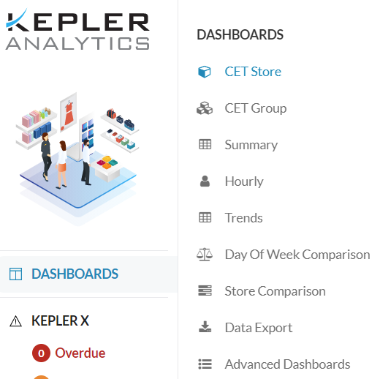
CET Overview
What does CET stand for?
Customer Engagement Tracker
Requirements:
Hourly POS integration
Sales targets
When should I use the CET?
Best practice 11.15am, 2.15pm, 4.15pm
Look at this dashboard (15 minutes past the hour)
Notes:
7CET Store DashboardTheCET Storepage provides you with a high-level snapshot of your stores’ daily and weeklyperformance, while also providing you with a prediction of the expected outcome using thelive trends being experienced.

Slide 45

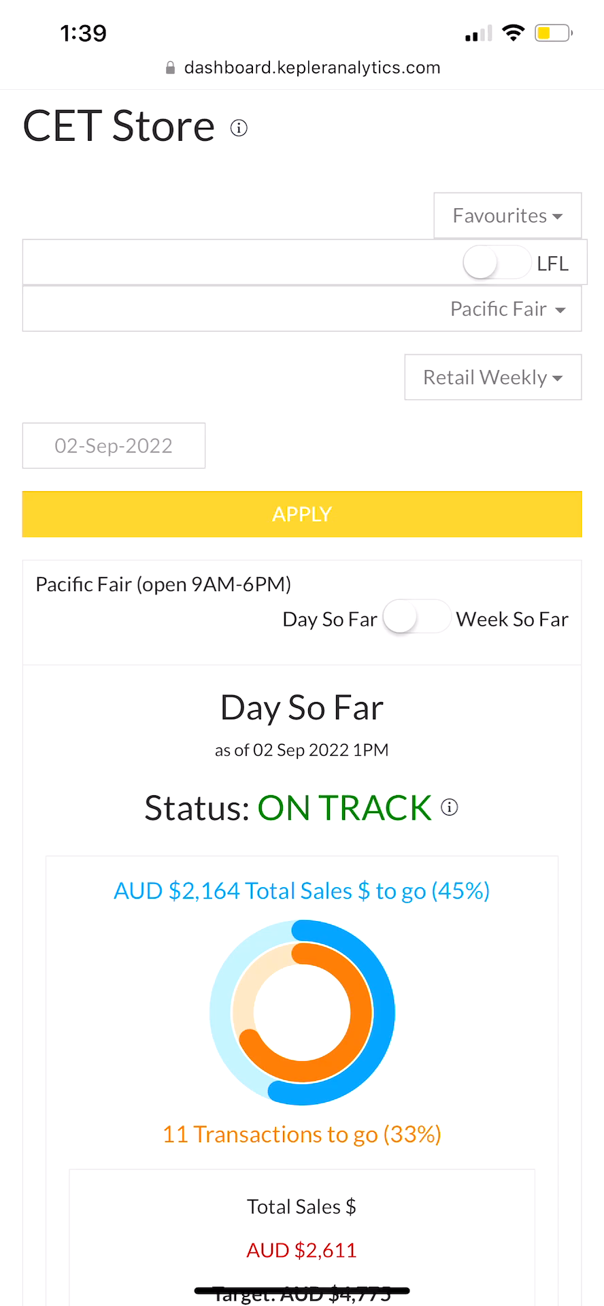
The Power of CET
What is it used for?
Eagle eye view of your business
Increase your productivity when analysing your business
Celebrate where you are winning
Identify golden opportunities where to focus your time throughout the day to achieve your target
Provides you with a prediction of the expected outcome using the live trends being experienced in store

Slide 46



Understanding the Results
Celebrate
Celebrate the wins
Identify why we achieved the result to ensure result is maintained
Team Huddle & Set A Focus
Identify golden opportunity
Huddle with Team to discuss goal and plan to improve
Put into action
Review
Review results throughout the day
Reflect on results and repeat steps 1-2

Slide 47

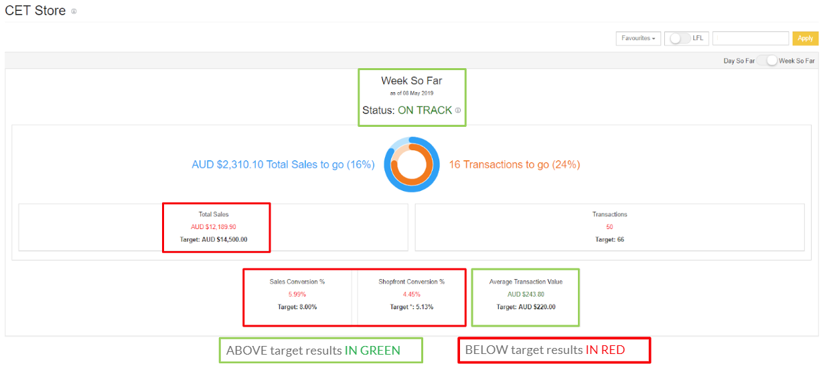
A Day In The Life Of
Notes:
7CET Store DashboardTheCET Storepage provides you with a high-level snapshot of your stores’ daily and weeklyperformance, while also providing you with a prediction of the expected outcome using thelive trends being experienced.

Slide 48


Area Manager - The Juggle
Recruitment
Operations
Customers
Costs
People
Sales

Slide 49
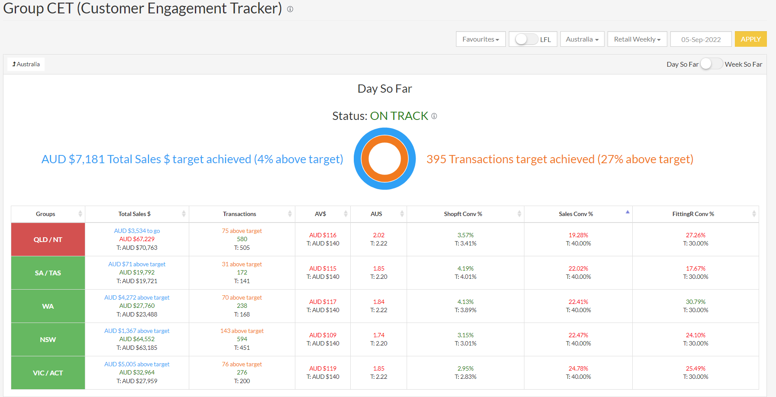
Be More Productive

Slide 50
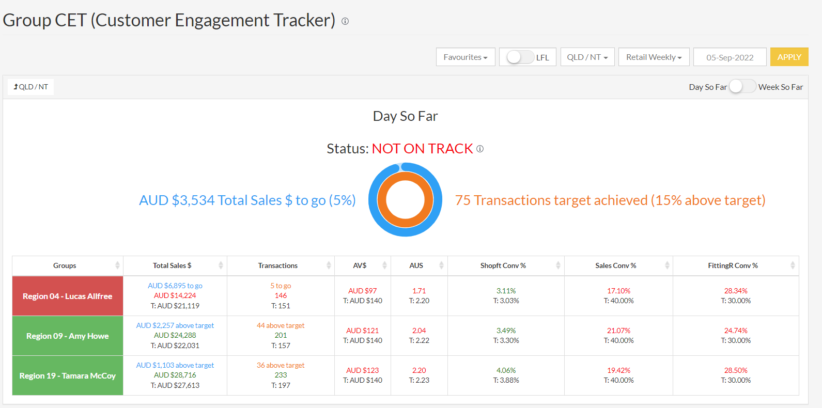
Identify The Opportunities
Mary
Sally
Joe

Slide 51

What is the Focus Worth?
$0

Slide 52
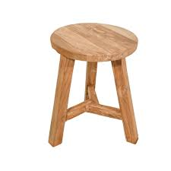
Customer Success
3-Legged Stool
Ultimately, if one of these legs break, the Customer doesn’t succeed
Customer
People
Output
Process

Slide 53
3-Legged Stool
How do I improve Customer experience and grow our sales?
People
Skill vs will
Expertise
Process
Visual merchandising
Output
Customer service and experience
Skill set
Customer to staff ratio
Product offer
Promotion
Marketing execution & offer
Rostering
Pricing strategy
Culture

Slide 54
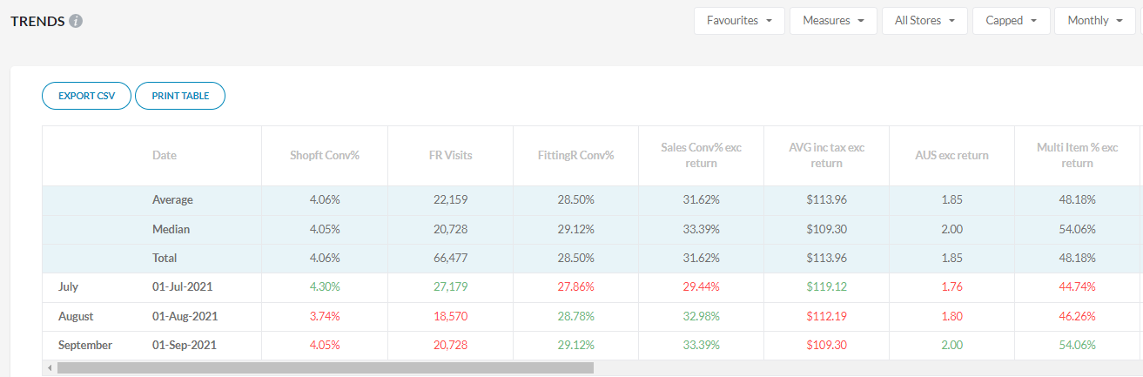

Trends Dashboard - Month
How do I validate if my business focus was effective?
IPS

Slide 55
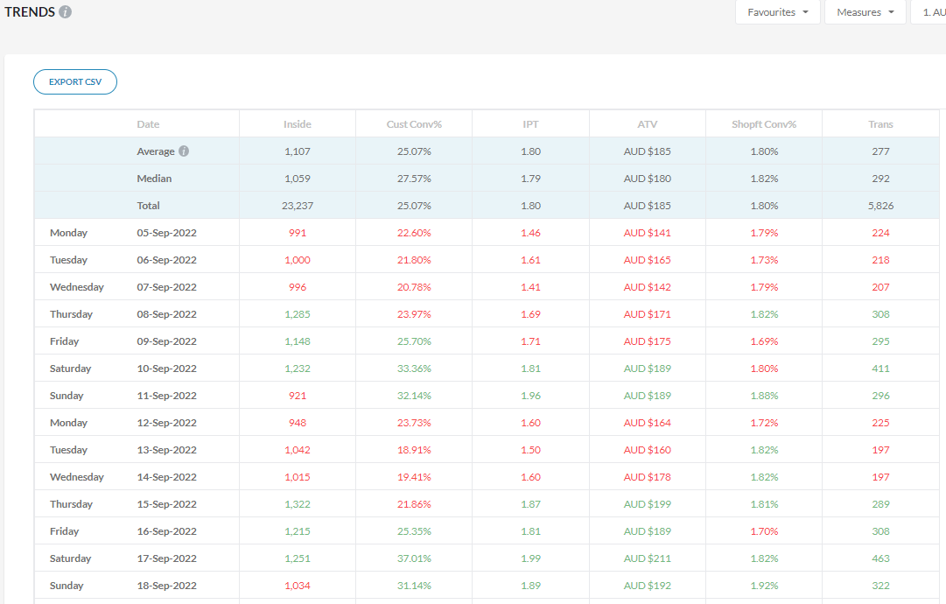
Trends Dashboard - Daily

Slide 56
What Does This Mean?
Size of the prize?
If we increase the Sales Conversion % on a Friday by 3%:
39 additional Customers would purchase
An additional $7,495 for the week
$389,000 annually in extra revenue

Slide 57
Summary
CET dashboard will give your Store and Area Managers visibility of the live trends being experienced in store
Will clearly outline what behaviours and measures require focus to see improved performance
Customise what you see on your CET – what is important to you?
CET Group will give your leaders more time back in their day to focus on the coachable moments and steer their energy and time in the right places
Leaders can utilise the Trends dashboard to identity when and where your Customer is or isn’t succeeding
Great reflection tool for monthly business reviews
Validate if your focus or strategy is making an impact - People, Process and Output

Slide 58


Questions

Slide 59

The Marriage of DATA and Human Design
Terry Hawkins – Custodian & Navigator, Ignite Worldwide
Terry Hawkins has built an international reputation as a transformative and insightful speaker & facilitator – often quoted as being able to significantly shift an entire audience to action, from the CEO across to the frontline. She was inducted into the Hall of Fame as “Educator of the Year” for the National Speakers Association in Australia in 2010, and is the author of Why Wait to Be Great?: It’s Either Now or Too Late.

Slide 60






The Future of Retail Technology
Paul Weingarth
CEO
Howard Amolis
Retail Growth Strategist
Gary Stubbs
Co-Founder

Slide 61
Journey and Basket Mapping
Maximising Customer Value
Tony De Fazio – Director of Product

Slide 62
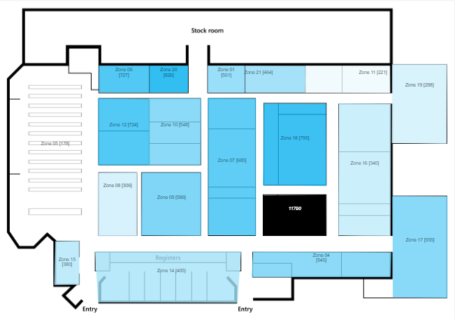
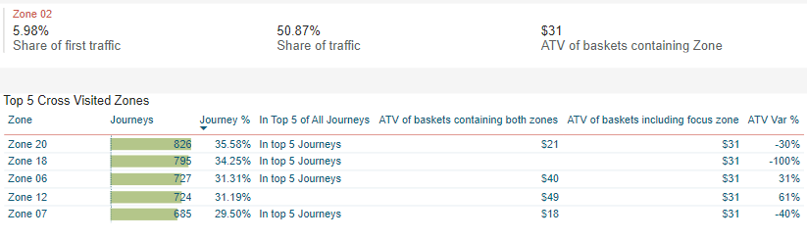
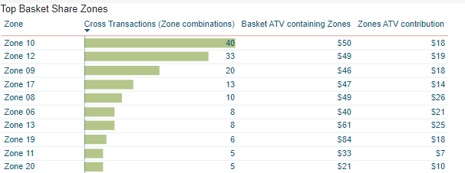
Maximise the value of traffic in store
Use customer journeys to define most trafficked pathways
Overlay basket profiles to define highest value opportunties
Engage Merchandise to increase basket sizes and product connections
Engage Store Planners to realise journey connection value

Slide 63
Section 2
Live Demo

Slide 64

Advance Analytics: Seeing the Data Forest from the Trees
Miles Ruge – Client Director

Slide 65

Advance Analytics
Avoid analysis paralysis, and simplify the process of review and driving insightful, data-lead action
See the forest from the trees – establish the trend(s) in your business, area, or store quickly and clearly
Application of data and insights to wider business and cross-functional departments: marketing, merchandise, product etc.

Slide 66
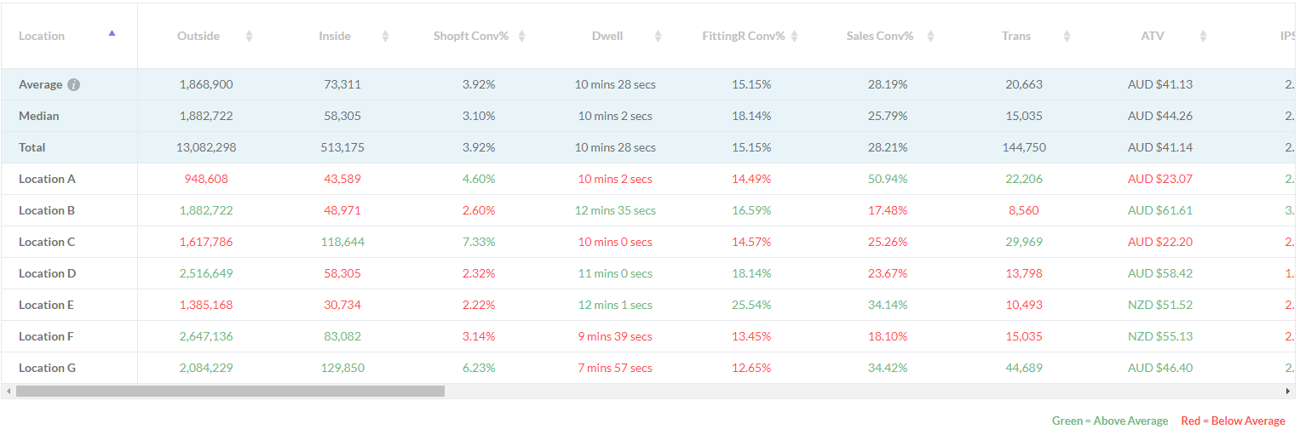
What does this tell me?

Slide 67

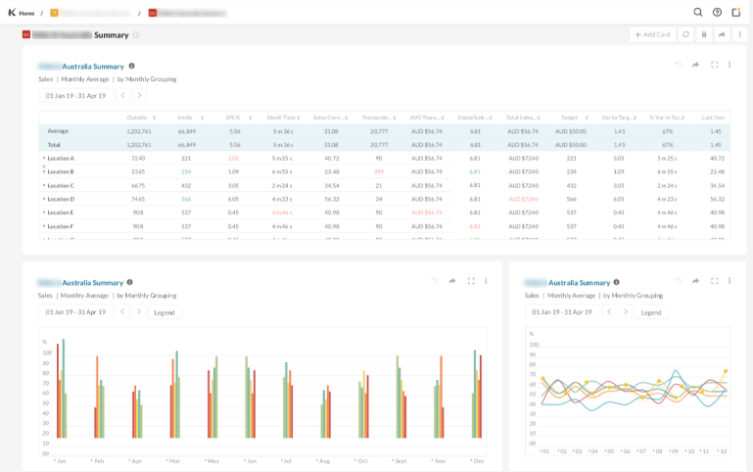
Advance Analytics
The power of Kepler is the wealth of information and data. The problem can be making sense of all of this data – seeing the why, how and most importantly what to do next
In this session, we will explore 2 Kepler Dashboards that will add value to your analytical process: Store Comparison and Day of the Week Comparison Dashboards
You will learn how to access and use the Dashboards, best practice and suggestions around advanced usage that will add value to your business

Slide 68
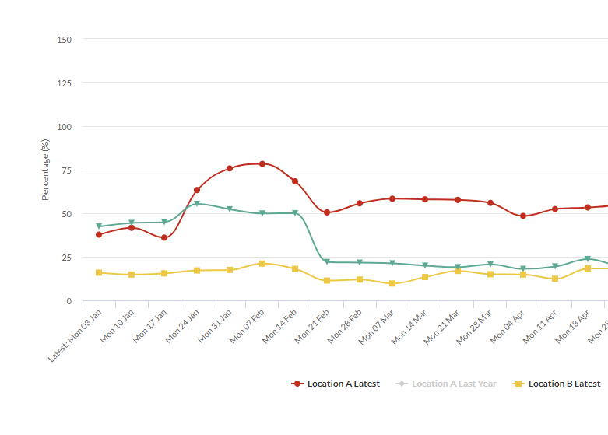
Store Comparison Dashboard
The Store Comparison Dashboard allows you to compare metrics for different time periods against one another and displays this information in an easy to compare line graph
Allows you to compare select locations from your entire network
If you have a marketing/promotional calendar integrated, selecting “enable calendar events overlay” with overlay these dates with the data, allowing you to add context to the results and feed vital information back to cross-functional teams

Slide 69
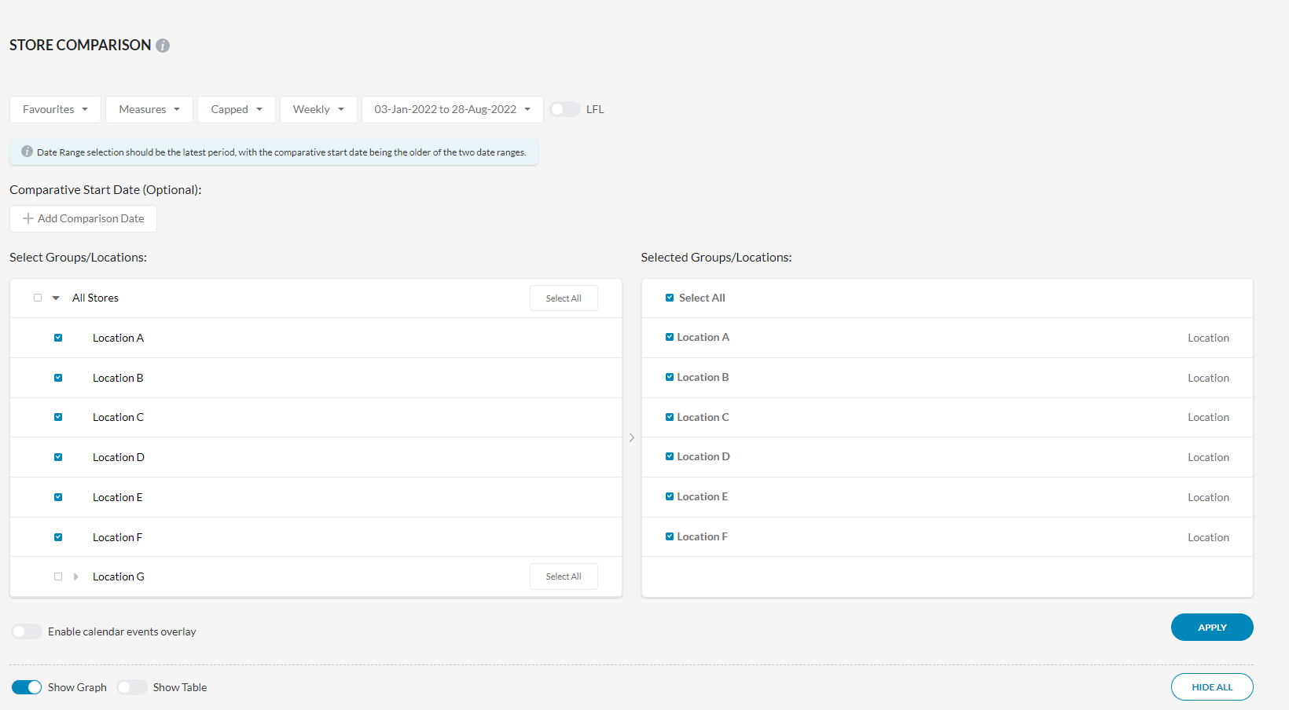
Store Comparison Dashboard
Select groups/locations to compare
Add a comparative date range, to review performance
Marketing calendar overlay

Slide 70
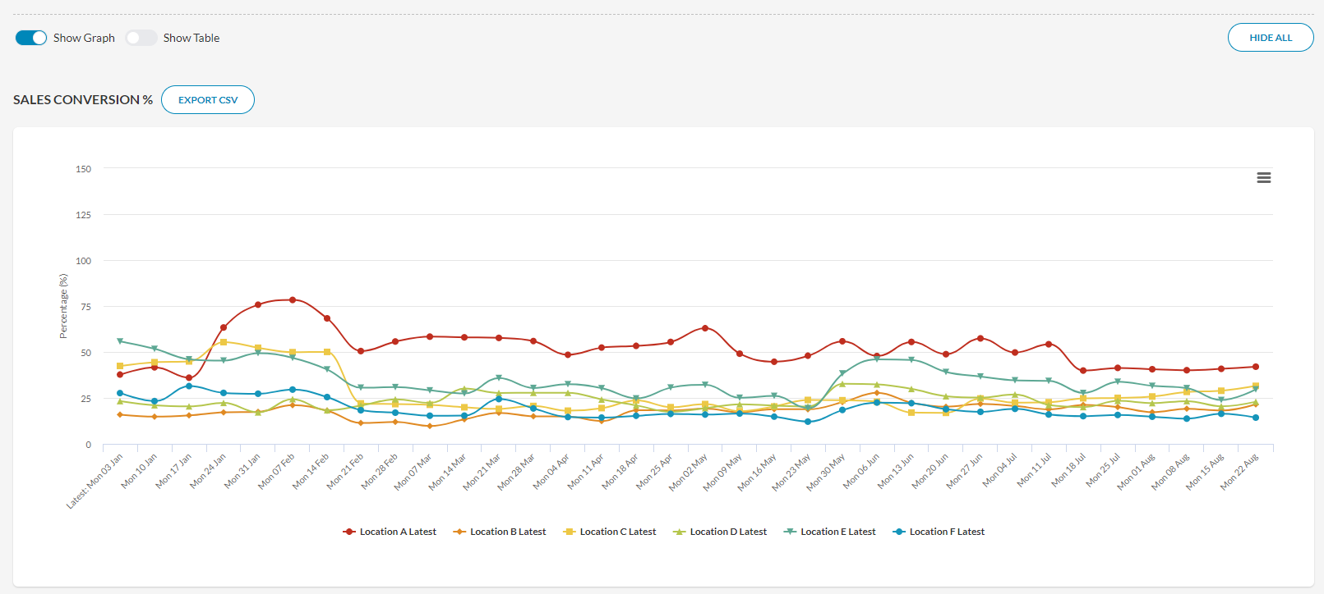
Store Comparison Dashboard
Visually establish under or overperformance
All chosen metrics are shown individually
Easily see changes in performance

Slide 71
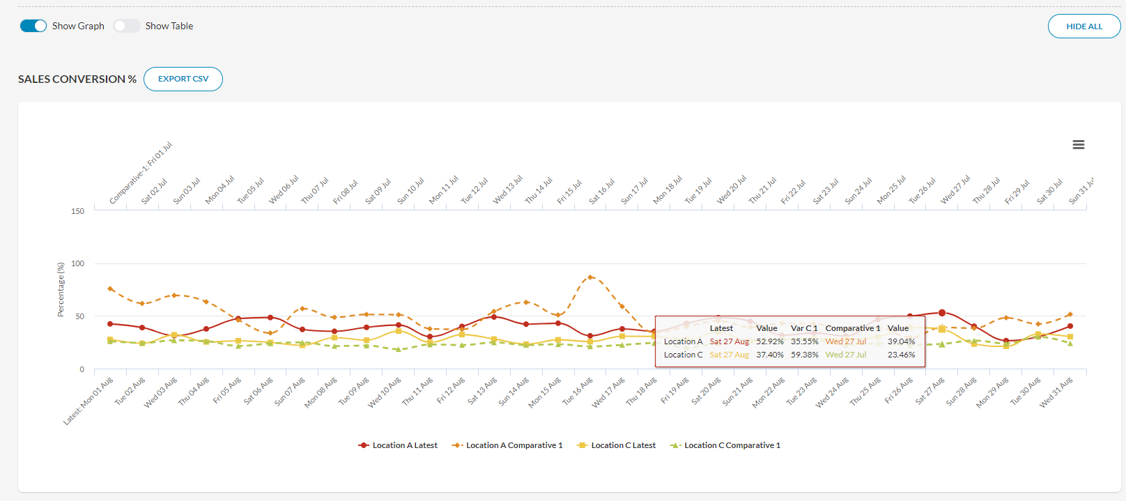
Store Comparison Dashboard
Comparative date range(s), shown here
Track the change in performance for location(s)
Comparative variance is shown

Slide 72
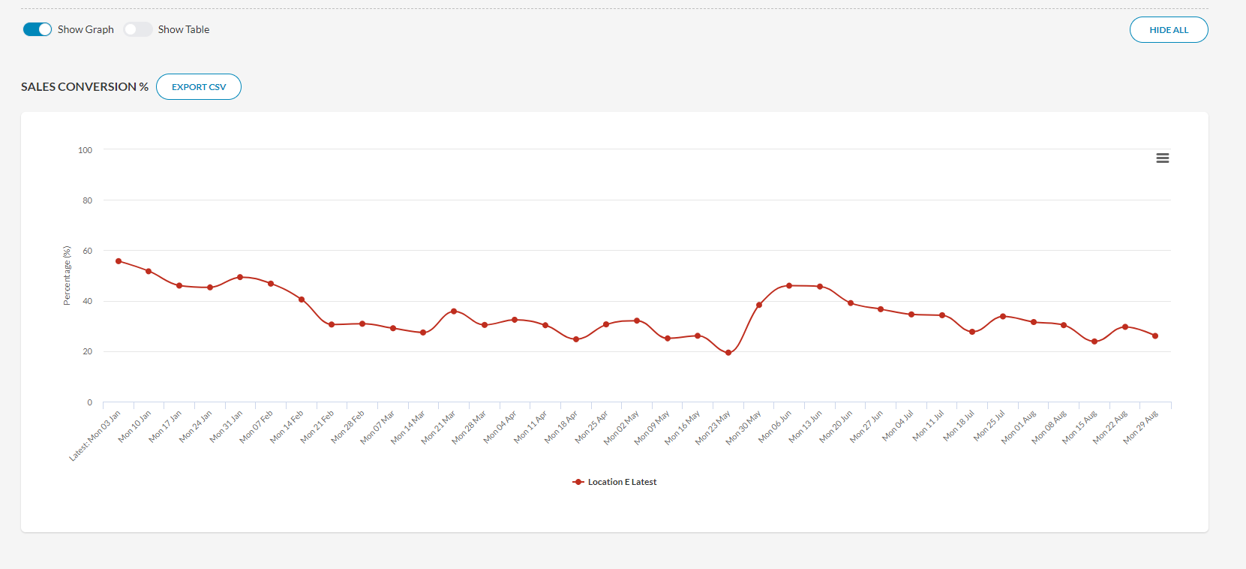
Store Comparison Dashboard
Visual representation of location(s) long-term trend
Isolate and align performance variance to actions
Chart subtle changes in performance
Notes:
Location E – 28% variance in SC in 8 months, 18% in 2 months

Slide 73
Store Comparison Dashboard
The Store Comparison Dashboard allows you to compare the performance of your entire network, across all measures, and quickly identify and drill down into opportunity locations
You can add comparative date ranges, and look to easily track the performance of a location or locations against a prior month or any chosen prior period
For individual locations, a long-term view of performance can help to identify subtle, gradual changes or trends that are not as easily identified in granular views of the data or dashboards
For marketing, merchandise and Support functions, the marketing/promotional calendar allows to visually see the impact of promotions, product and activity across the store network – success and opportunity

Slide 74
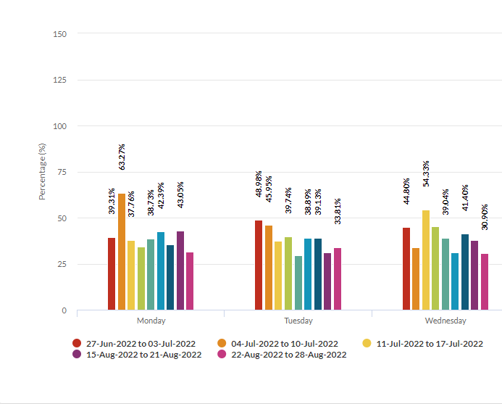
Day of Week Comparison Dashboard
The Day of the Week Comparison Dashboard allows you to compare metrics for different days across different time periods
For example, the Day of the Week Comparison Dashboard can show you an easy to access numerical/visual representation of the Outside traffic for each day (on average) across 3 months
A great visual representation of a business, area, or store across a period of time and allows for inconsistency, downward or upward trend(s) in performance to be quickly identified

Slide 75
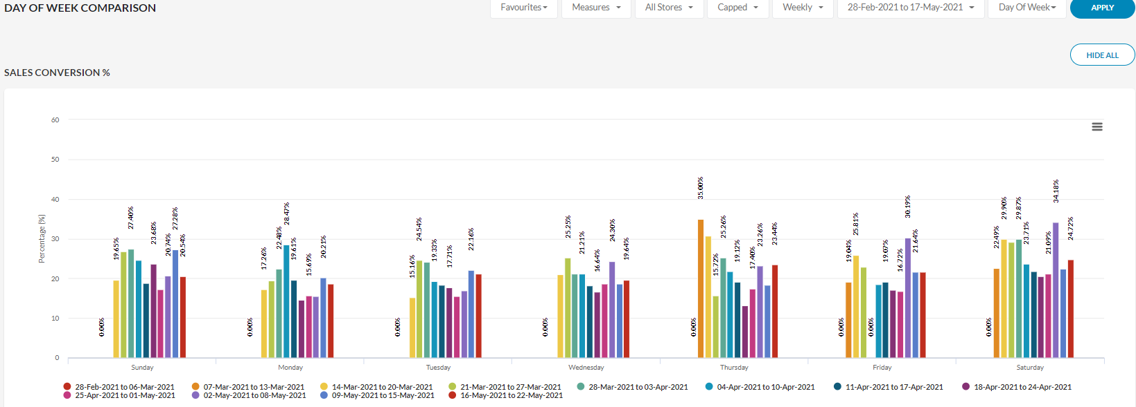
Day of Week Comparison Dashboard
Results are grouped by
“Day of Week”
A wide date
range – 4-8 weeks works best
Changes in trends will be highlighted

Slide 76
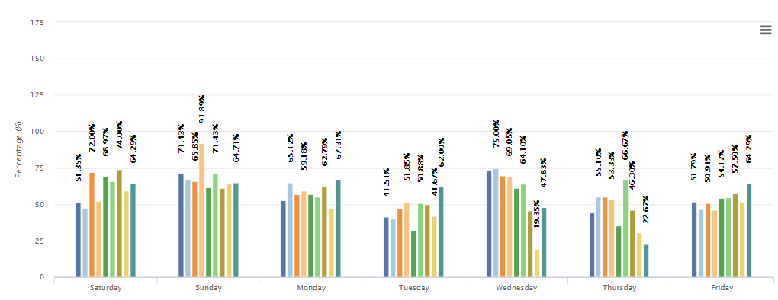
Day of Week Comparison Dashboard
Inconsistency
Downward Trend
Upward Trend

Slide 77
Day of Week Comparison Dashboard
For frontline teams, Store Managers and Area Managers, Day of the Week Comparison allows for opportunity analysis – where they are winning and where performance is below requirements or expectation. This allows them to drive meaningful change, where it matters most, taking the learnings from their best days of the week
For Support or Head Office functions, it allows a visual view of the cadence of the business across the week – showing high-level traffic insights, Customer behaviours, and opportunity around coaching and support requirements for select regions or stores
An agile dashboard that can be adapted to show the most meaningful insight in the least amount of time. Save time, and effort in review and spend the time driving action and outcomes

Slide 78
Practical Application
We’ve all sat in a trade meeting, met with a CEO or business owner and been asked the question: what happened in the business, why and what’s the resolution?
Gain back time in the review of your entire business, state, area, or region. Avoid analysis paralysis, and simplify the process of review and driving insightful, data-lead action. See the forest from the data tress – what is the big picture that is happening in my business and how do we challenge or reward it?
Store Comparison & Day of the Week Comparison allow you to visually chart the performance of your business across a given period, comparing store against store, or day against day – highlighting subtle changes, that might not be clear in weekly reviews but have serious impact to topline revenue

Slide 79

Section 1
Kepler Analytics Performance Awards

Slide 80

Kepler Business Integration Award

Slide 81
Kepler Business Integration Award

Slide 82
KWAY 1st Class Honours Award

Slide 83
KWAY 1st Class Honours Award

Slide 84
Kepler Innovation Award

Slide 85

Kepler Innovation Award

Slide 86
Kepler User of the Year

Slide 87
Kepler User of the Year
Tennille Lee

Slide 88

Thank You!
We’d love your feedback

Slide 89
Closing Address
David Gordon – CEO, Kepler Analytics
David Mah – Managing Director

